Slide 1

Module 1
Regression Basics
Notes:
Guidelines
Use section headers to chunk content in your presentation.
Use the same style of section header throughout your presentation.
Keep your title to no more than 2 lines.

Slide 2
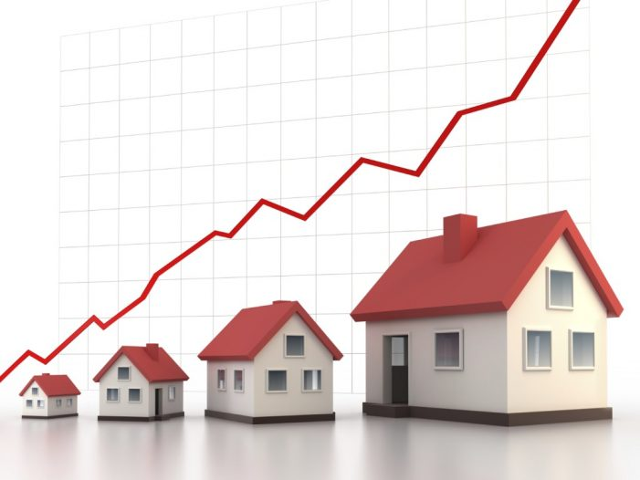
Home Market Values
Notes:
Guidelines
Use a title slide at the beginning of your presentation. There are 9 variations of title slides to choose from.
If you will have a series of slideshows, we recommend using the same style of title slide for each presentation.
Keep your title to no more than 2 lines.
Do not change the font style or font size of the title or subtitle.

Slide 3
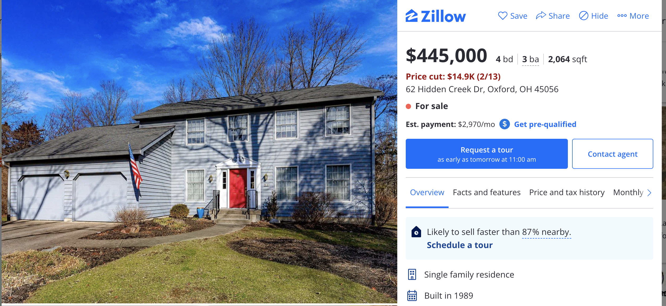
Goal
??????
House Age: 34 years
Square Footage: 2,064 sqft
Market Value: ????

Slide 4
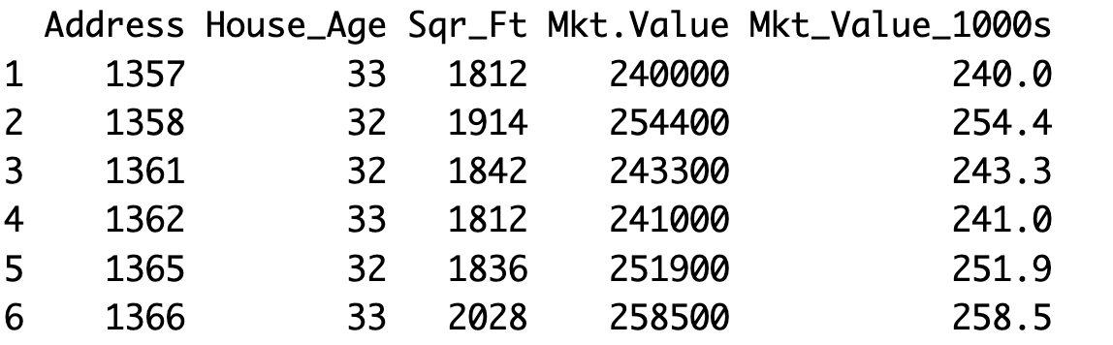
Data
Response: market value of homes in $1,000s
Predictors: house age (in years) and square footage (in feet)
X
y

Slide 5
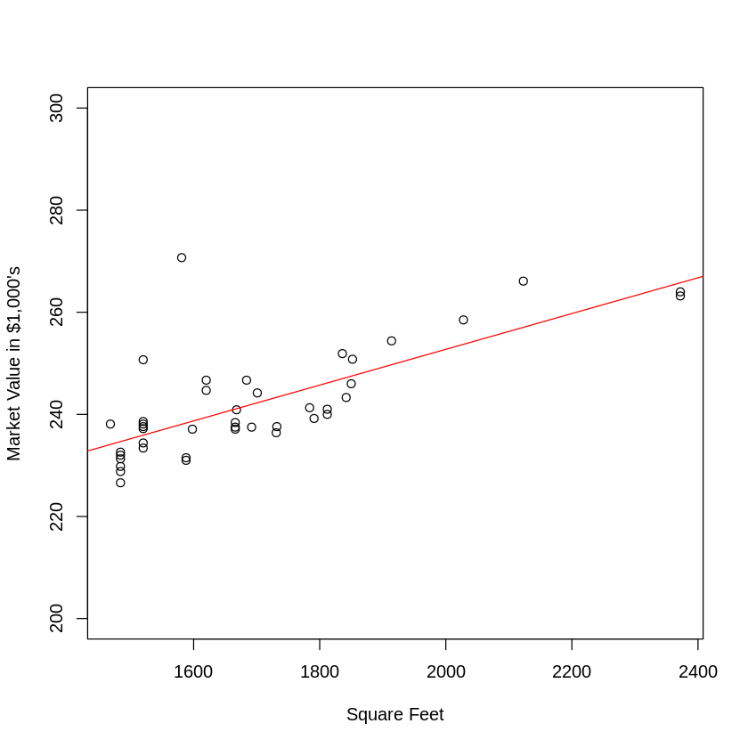
Data
Using simple linear regression does NOT take into account the joint relationships of variables

Slide 6
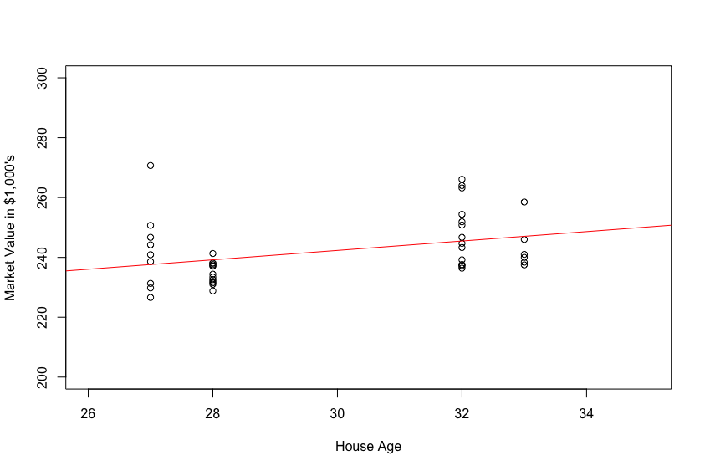
Data
Using simple linear regression does NOT take into account the joint relationships of variables
extrapolation

Slide 7
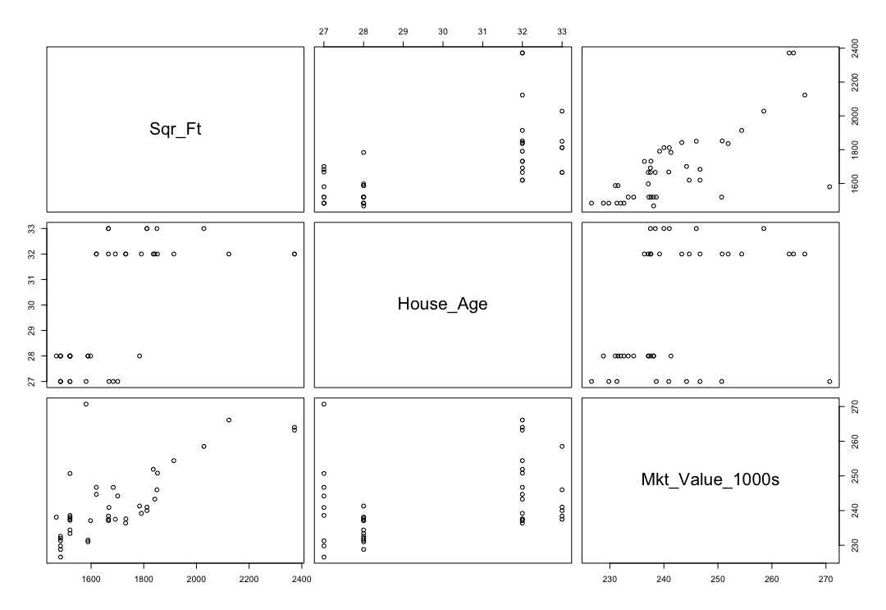
Scatter Plot Matrix
If two predictors bring redundant information to the model, the joint effect to predicting the response will not be as powerful

Slide 8
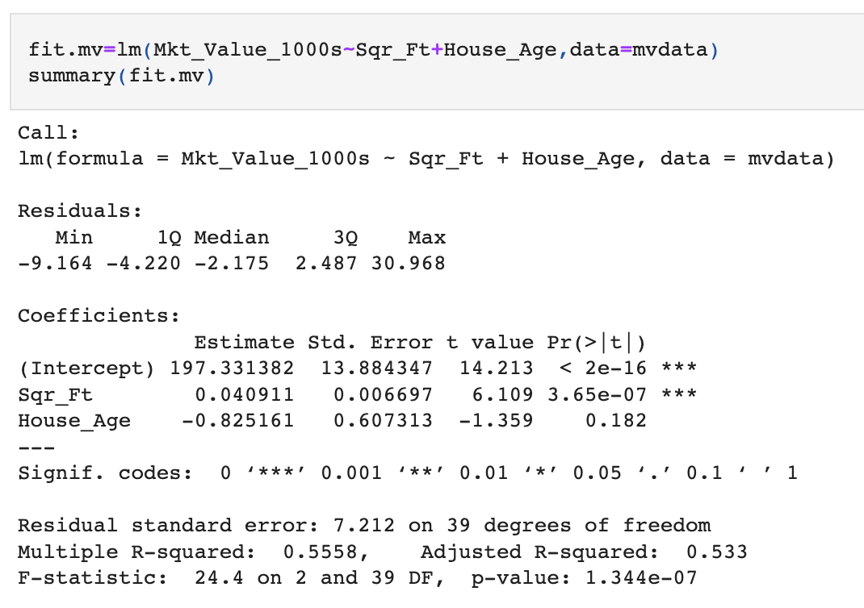
Estimates

Slide 9
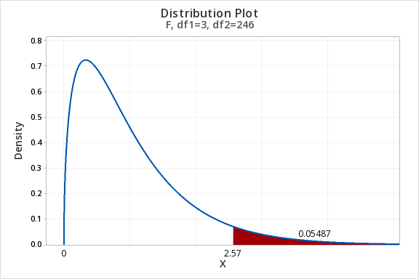
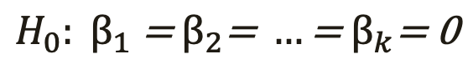
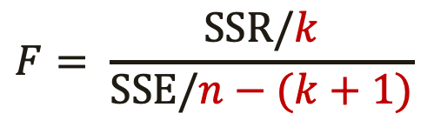
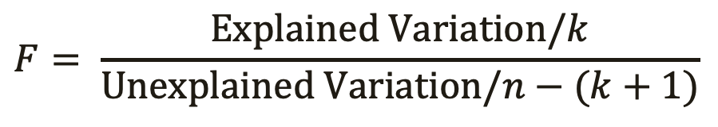
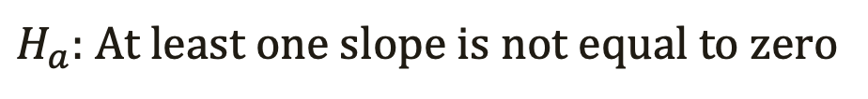
Overall Test of Significance
Hypothesis Test
Test Statistic
$$H_{0}: β_{1}\text{ = }β_{2}\text{= }…\text{= }β_{k}\text{= 0}$$
$H_{a}:$ At least one slope is not equal to zero
$$F= \frac{Explained Variation/k}{Unexplained Variation/n−(k+1)}$$
$$F= \frac{SSR/k}{SSE/n−(k+1)}$$
Numerator df
Denominator df

Slide 10
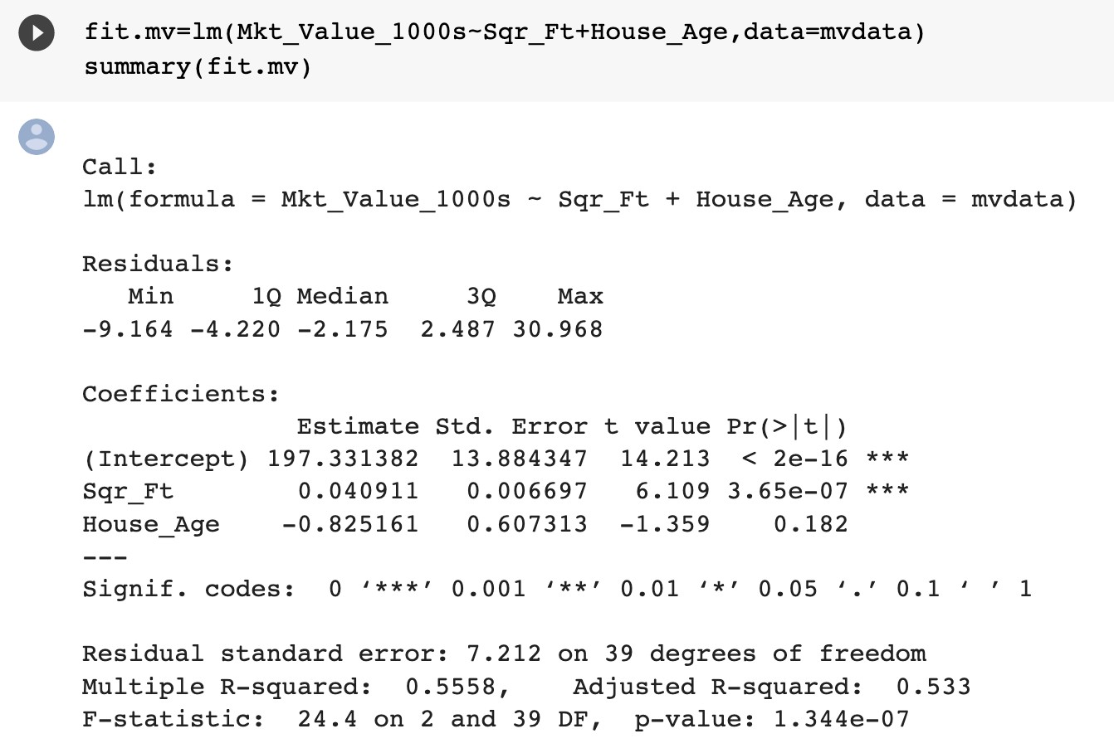
F-Statistic

Slide 11
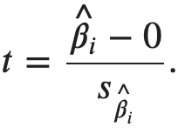
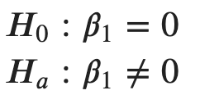
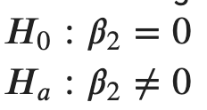
Partial Significance

Slide 12

Practice

Slide 13
R² vs Adj-R²
Adding a predictor to multiple regression will always raise R²
The adj-R² is the preferred metric for explained variation

Slide 14
Practice

Slide 15
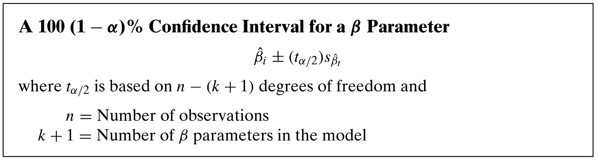
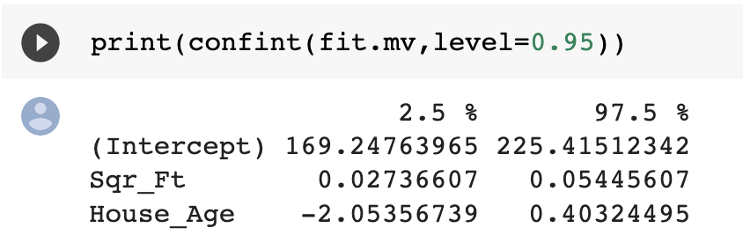
Confidence Intervals on Estimates
CIs on parameter are often helpful in determining significance

Slide 16
Practice

Slide 17
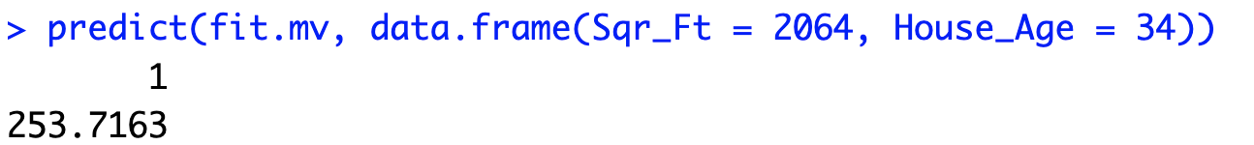
Point Estimates
??????

Slide 18
Point Estimates
??????
House Age: 34 years
Square Footage: 2,064 sqft
Estimated Market Value: $253,716.3

Slide 19
Point Estimates
$$e=y−\hat{y}$$
Actual Market Value: $445,000
Estimated Market Value: $253,716.3

Slide 20
Practice

Slide 21
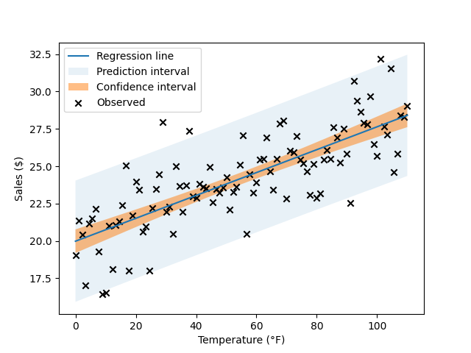

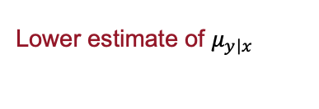

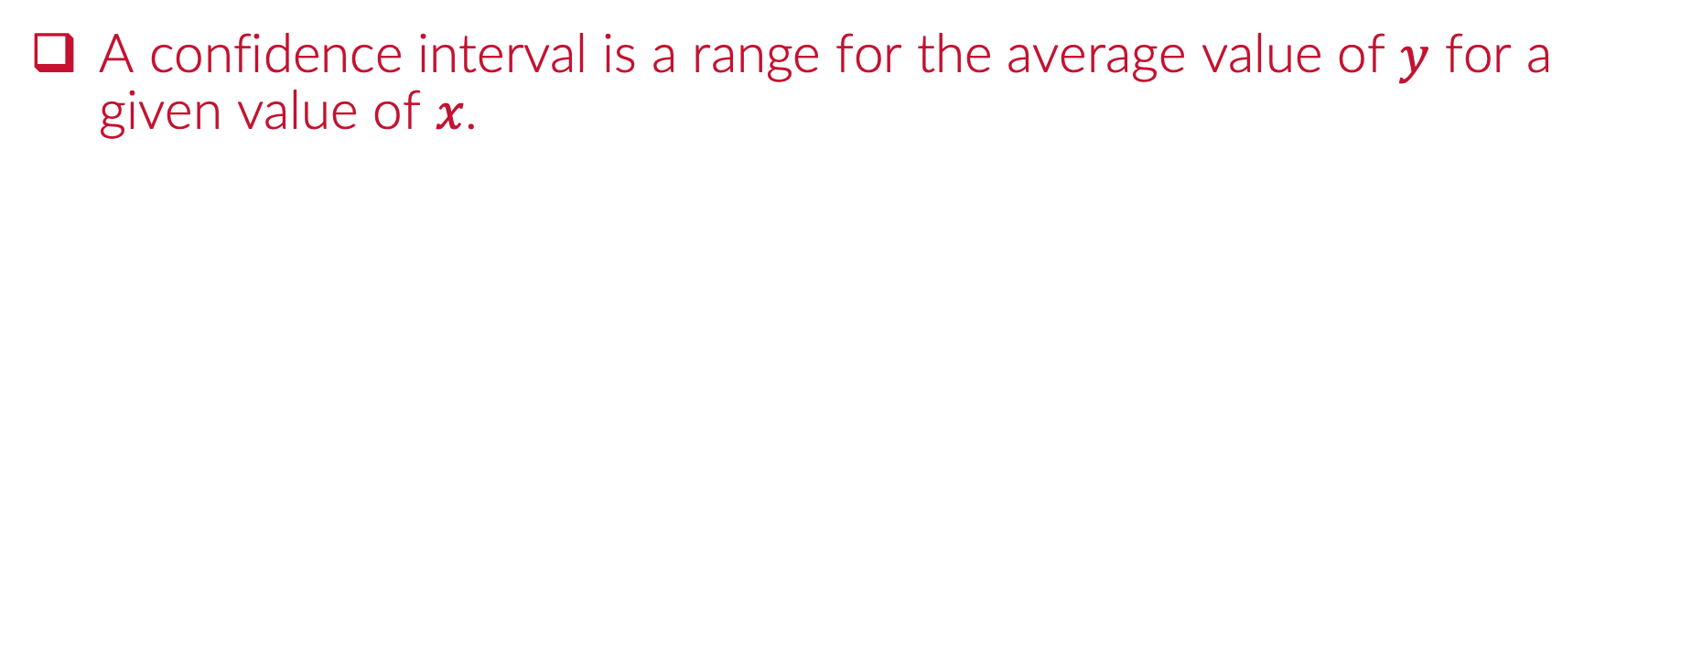
Confidence Interval on $μ_{y\left|x\right.}$
A confidence interval is a range for the average value of $y$ for a given value of $x$.
Upper estimate of $μ_{y\left|x\right.}$
Lower estimate of $μ_{y\left|x\right.}$

Slide 22

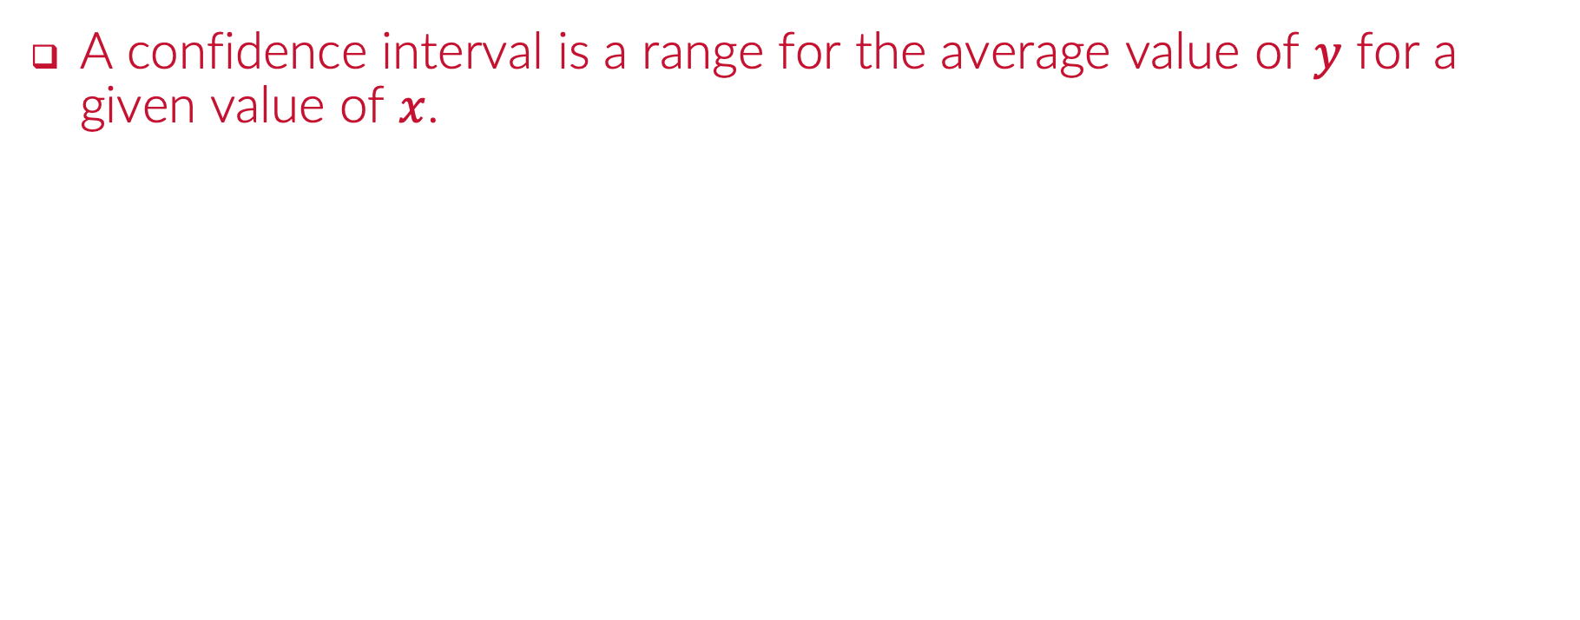
Prediction Interval on $y$
A confidence interval is a range for the average value of $y$ for a given value of $x$.
Upper prediction for y
Lower prediction for y

Slide 23
Point Estimates
$$e=y−\hat{y}$$
Actual Market Value: $445,000
Confidence Interval?

Slide 24
Point Estimates
$$e=y−\hat{y}$$
Actual Market Value: $445,000
Prediction Interval?

